Slide 1
Lecture 1 Introduction to Statistical Methods

Slide 2
Answering Questions with data
What proportion of people in the U.S are biologically female?
Survey Americans and ask them to report their sex
Does a low-carb diet result in significant weight loss?
- Design an experiment to evaluate the effectiveness of the low carb diet on weight loss
- Record information such as starting and ending weight, calories consumed per day, …
Are people more likely to stop at Starbucks if they’ve recently seen a Starbucks TV add?
Conduct a marketing survey to record the number of people who have gone to starbucks since add aired
Compare between those who saw the add and those who did not

Slide 3

Where do we find Statistics? – Everywhere!
Sports (number of points scored per game by an athlete)
Weather Forecasting (average monthly rainfall)
Economy (median income, unemployment rate)
Sales Tracking (projected sales revenue from iphone 14’s sold in a given month)
Medicine (percentage of people who were pain free from using a drug)
Manufacturing (number of cans of coke produced in a given month)

Slide 4
Where does statistics come from?
Statistics began as bookkeeping about people — counting births, deaths, and taxpayers so that a state could describe itself.
1662
John Graunt studies London's Bills of Mortality — the first life table built from real data.
1749
Gottfried Achenwall coins “Statistik” — literally the science of the state.
1830s
Adolphe Quetelet applies the normal curve to human traits and invents “the average man.”
1925
R. A. Fisher formalizes experimental design, ANOVA, and significance testing.
1693
Edmond Halley's Breslau life table makes it possible to price life annuities.
1790
The first U.S. census counts the population. Great Britain follows in 1801.
1900
Galton and Pearson develop correlation, regression, and the chi-square test.
Today
The same ideas, now run by computers on data far larger than Graunt could count.
Sources: J. Graunt (1662), Natural and Political Observations Made upon the Bills of Mortality. E. Halley (1693), Phil. Trans. R. Soc. 17:596–610. G. Achenwall (1749), Abriss der neuesten Staatswissenschaft. A. Quetelet (1835), Sur l’homme et le développement de ses facultés. R. A. Fisher (1925), Statistical Methods for Research Workers.

Slide 5
The Science of Data
Statistical science deals with the collection, analysis, interpretation, and presentation of data
Data is a collection of observations/measurements, and can be structured or unstructured.
Structured data
Predefined format: fixed rows, columns and fields, easily stored in databases.
Examples:
Spreadsheets and CSV files
Survey responses, sensor readings
Transaction records
Unstructured data
No predefined format or fixed fields; requires processing before it can be analyzed.
Examples:
Free-text notes, emails, social posts
Images, audio and video
Web pages and PDF documents

Slide 6
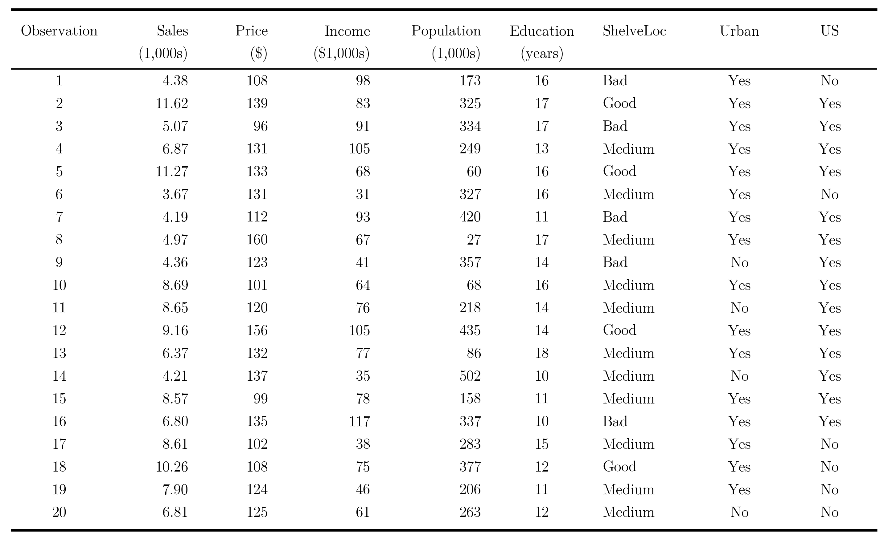
What Do Data Look Like?
The following table records sales of child car seats from 20 stores. For each store, the unit sales, price charged, community income, regional population, local education level, shelving quality, and whether the store is urban and in the U.S. are recorded
Reading a data table
Each column is a variable
Sales
Price
Income
ShelveLoc
Urban
4.38
108
98
Bad
Yes
11.62
139
83
Good
Yes
5.07
96
91
Bad
Yes
6.87
131
105
Medium
Yes
Each row is one observation — one store
Source: Carseats data set, R package ISLR2. James, G., Witten, D., Hastie, T., and Tibshirani, R. (2021). An Introduction to Statistical Learning, 2nd ed. Springer. Carseats is a simulated data set of 400 stores distributed with the textbook; 20 stores are shown here.

Slide 7
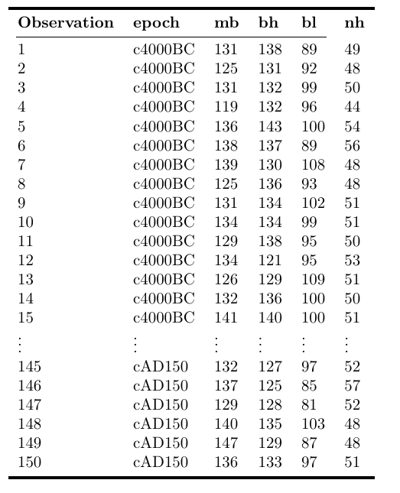
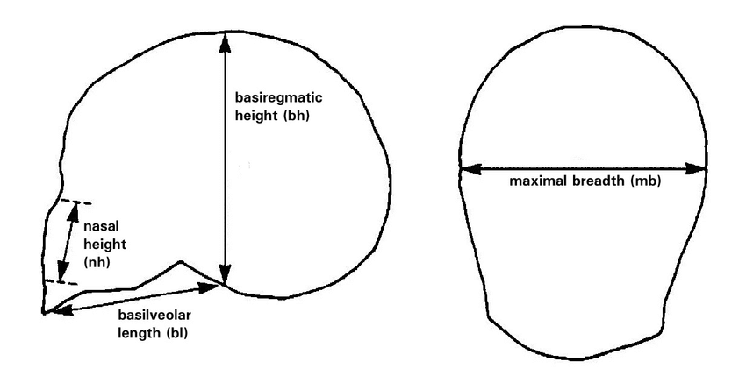
Example data 2
The following are data from an analysis of 150 Egyptian skulls from 5 epochs of Egyptian history. For each skull, the epoch, and several measurements characterizing the shape of the skull are recorded
Source: D. J. Hand, F. Daly, A. D. Lunn, K. J. McConway and E. Ostrowski (1994). A Handbook of Small Datasets, Chapman and Hall/CRC, London.
Visualizing Tests for Equality of Covariance Matrices - Scientific Figure on ResearchGate. Available from: https://www.researchgate.net/figure/Diagram-of-the-skull-measurements-for-the-Egyptian-skulls-data-set-Maximal-breadth-and_fig4_325126938 [accessed 21 Aug, 2023]

Slide 8
Checkpoint:
Data - a collection of observations/measurements on a set of variables - typically represented as a table.
Observation – the fundamental unit of data – typically observations are rows of a data table
Variables – characteristics of an observation – typically variables are the columns of a data table

Slide 9
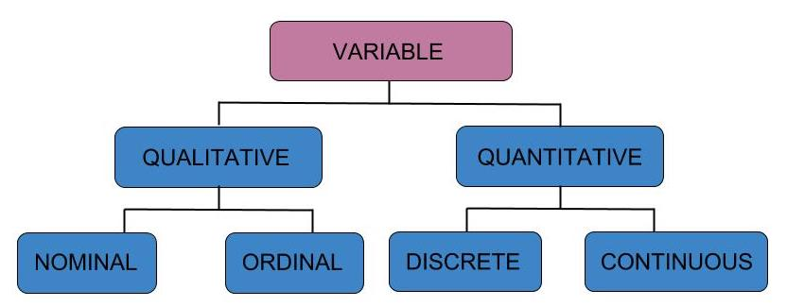
Types of Variables: Qualitative vs Quantitative

Slide 10

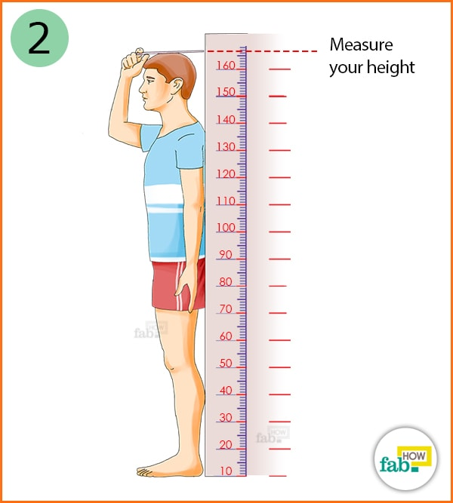
Types of Variables: Qualitative vs Quantitative
Qualitative (Categorical) variable – non-numeric qualities or characteristics that can be placed in distinct categories
State/city (ID, WA, MT, ...)
Treatment (Drug/Placebo)
Genotype (AA, AT, TT)
Survival (live or die)
Quantitative (numeric) variable – numerical characteristics - can be ordered or ranked
Height (inches/cm)
Weight (lbs/kg)
Longevity/Age (number of years)
Dose (micrograms per gram)

Slide 11

Practice: Qualitative vs Quantitative
From our example data of egyptian skulls, which variables are qualitative and which are quantitative?
Qualitative: Epoch
Quantitative: mb, bh, bl, nh

Slide 12
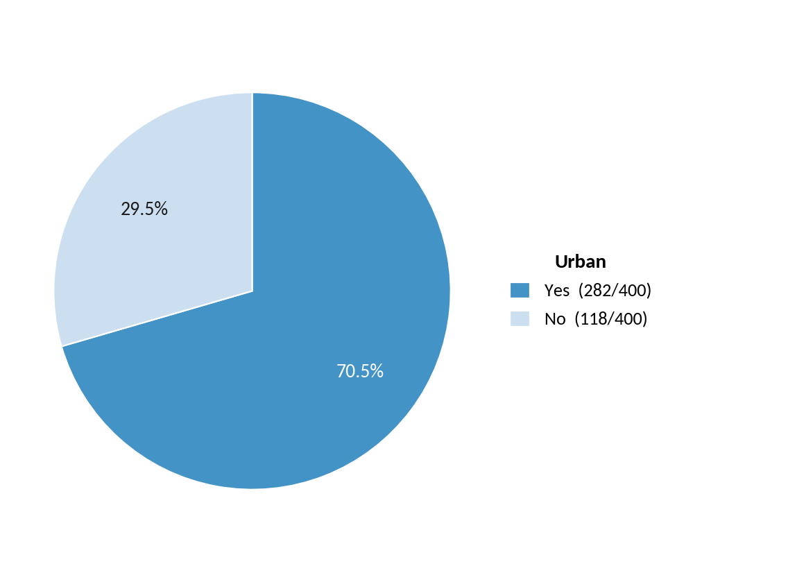
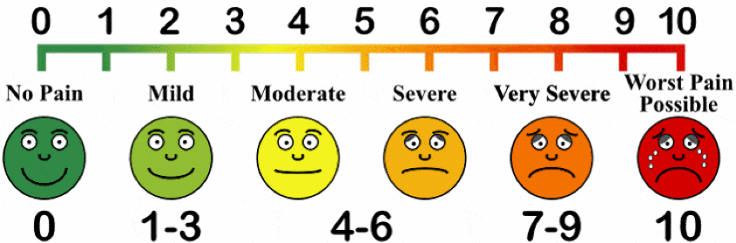
Types of Variables: Qualitative vs Quantitative
Qualitative nominal – non-numeric qualities or characteristics that can be placed in distinct categories that do not have a natural ordering (e.g labels, names, colors, etc)
Qualitative ordinal – non-numeric qualities or characteristics that can be placed in distinct categories with an inherent ordering (Likert responses, education level, military ranking)
This Photo by Unknown Author is licensed under CC BY-NC-ND

Slide 13
Practice: Qualitative vs Quantitative
In the Carseats example data, which variable(s) are qualitative nominal and which are qualitative ordinal?
Qualitative nominal: Urban, US
Qualitative ordinal: ShelveLoc (Bad < Medium < Good)
Carseats data set, R package ISLR2 (James, Witten, Hastie and Tibshirani, 2021); 20 of the 400 simulated stores shown.

Slide 14
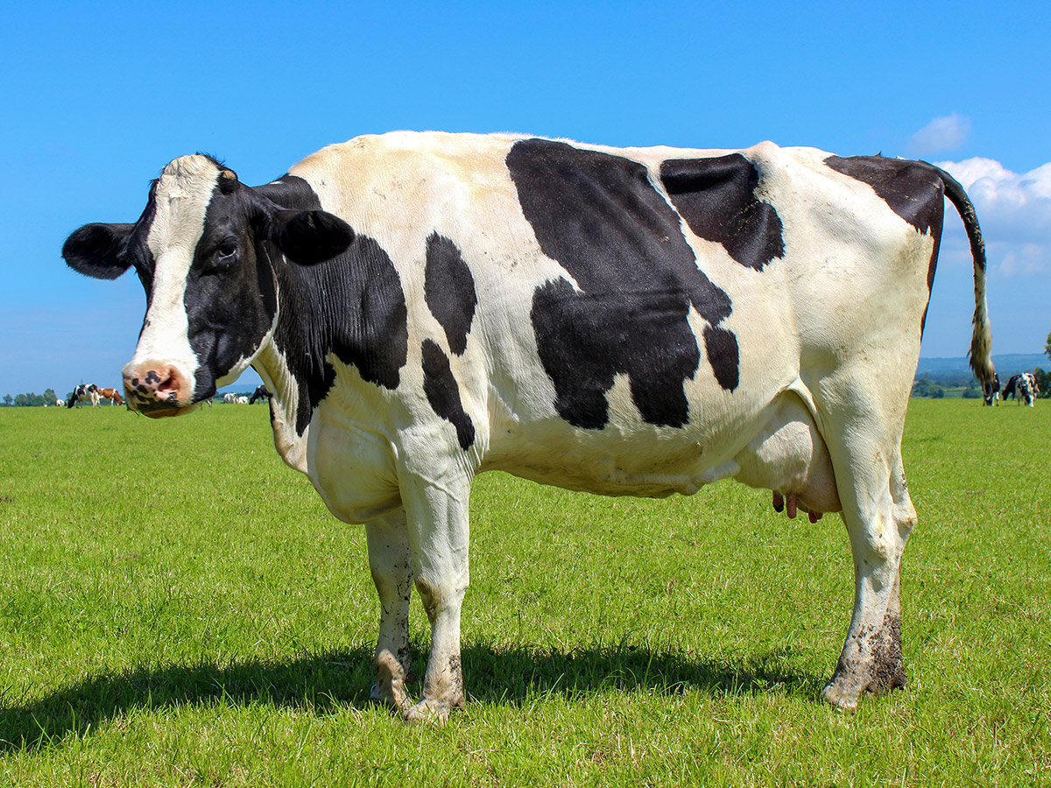


Quantitative Variables: Discrete vs Continuous
Quantitative discrete – quantitative variables that take on distinct, countable values such 0,1,2,3… (whole numbers or integers)
- all counts are quantitative discrete variables
Quantitative continuous – variables that can take on infinite number of values within an interval of any two specific values (e.g temperature ◦F, height in inches, speed in miles per hour)
e.g. number of black
spots on a dairy cow
Min
Max
Moscow, ID Daily Surface Temperature
(July)
$$40℉$$
$$97℉$$

Slide 15
Practice: Discrete vs Continuous
In the Carseats example data, which variable(s) are quantitative discrete and which are quantitative continuous?
Quantitative discrete: Population, Education (both counts)
Quantitative continuous: Sales, Price, Income
Carseats data set, R package ISLR2 (James, Witten, Hastie and Tibshirani, 2021); 20 of the 400 simulated stores shown.

